Slide 1
Commenting in a model
For workshop participants

Slide 2
Common Model
Common model represents information requirements
Distilled from the complete ‘Uber model’
Uses FHIR datatypes and Terminology server interaction
Can filter/display values for a coded element
Comments:
Can be made against any element
or the model as a whole
Can make notes against the comments
Represented as FHIR Tasks for formal disposition

Slide 3
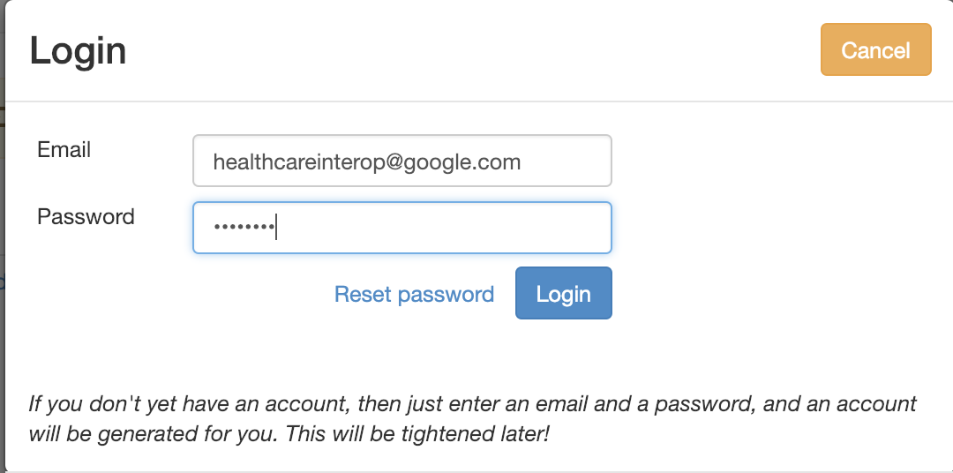
Login
Just email and password
Allows Comments and Notes to be added
Anyone can view
Can’t edit model
Not used for anything alse!

Slide 4
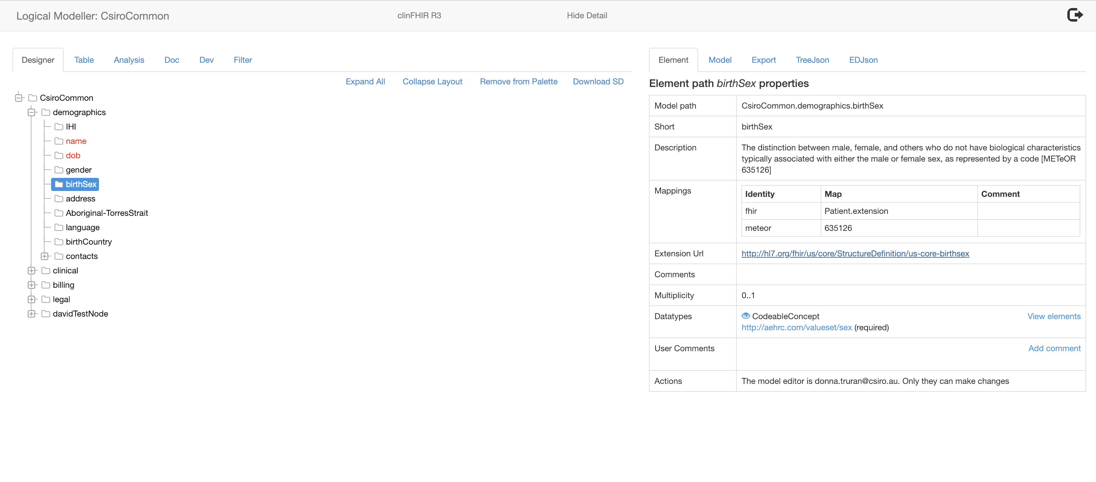
Model: Designer view
Details
Select Element

Slide 5
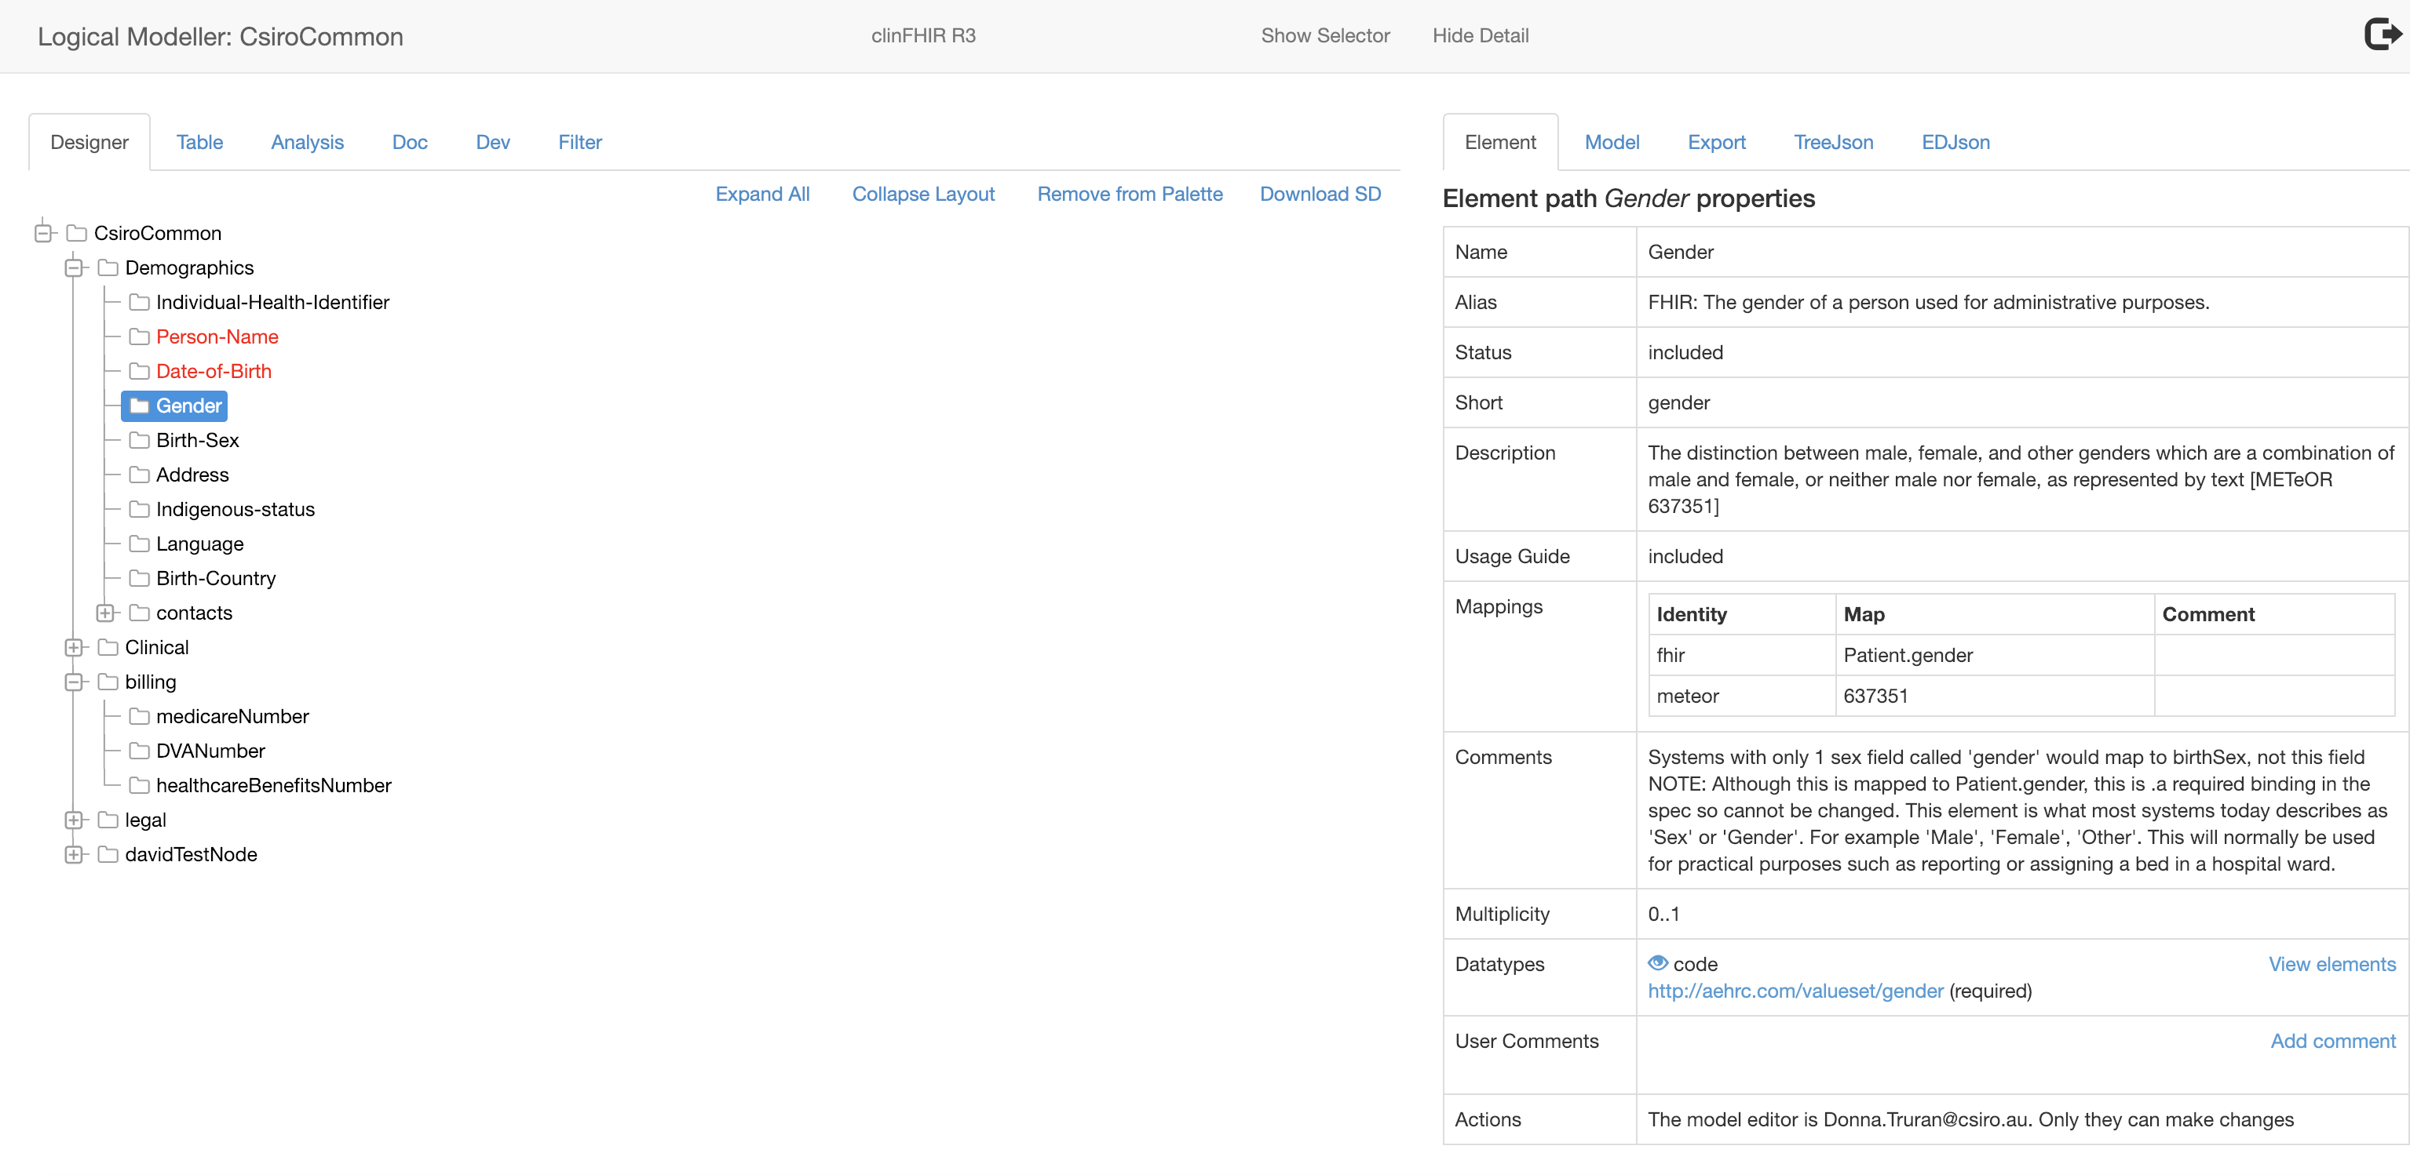
Model: Designer view
Details
Select Element

Slide 6
Model: Element Details
How sure we are about this element
‘type’ of element
(view parts)
Select Element

Slide 7
View Details of a ValueSet
Click link to view

Slide 8
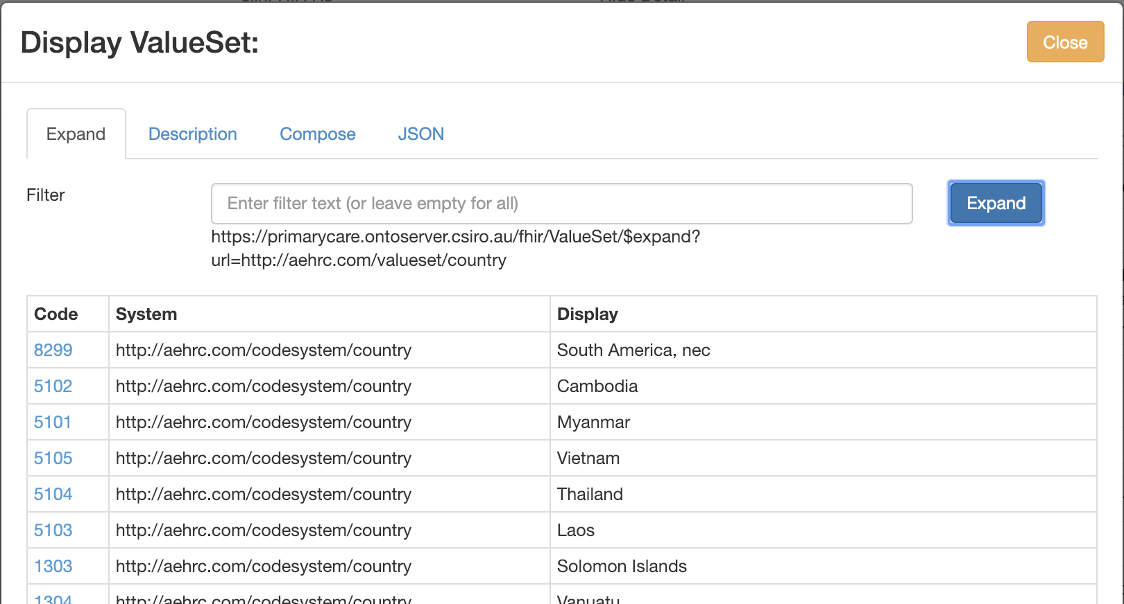
ValueSet browser
Click to view matching concepts
Filter by concept name

Slide 9
Making comments
Anyone can make a comment
Must be logged in
Otherwise view only
Can be for the whole model or an element
Can make notes about someone else's comment
Possibilities
Suggest new name
Update to element description or cardinality
Suggest it not be included
Comment on ValueSet

Slide 10
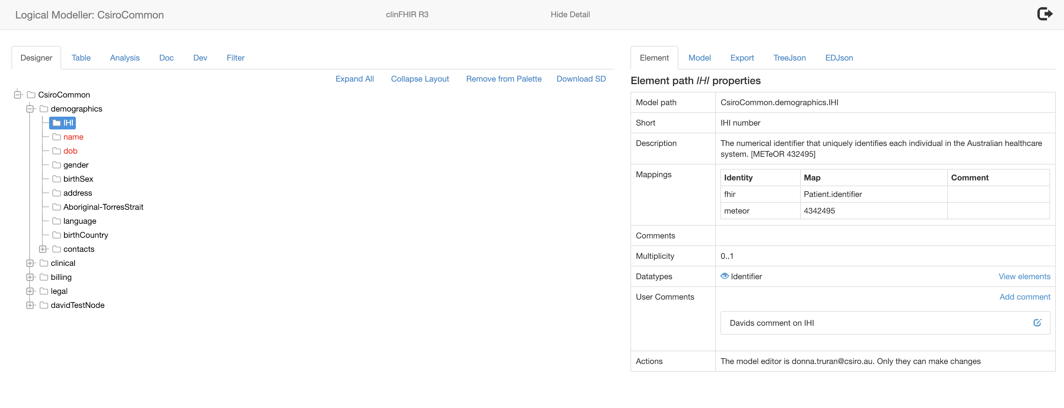
Comments
Add a new comment
(Logged in user only)
Edit comment
(Anyone can view)
Add a note – logged in user

Slide 11
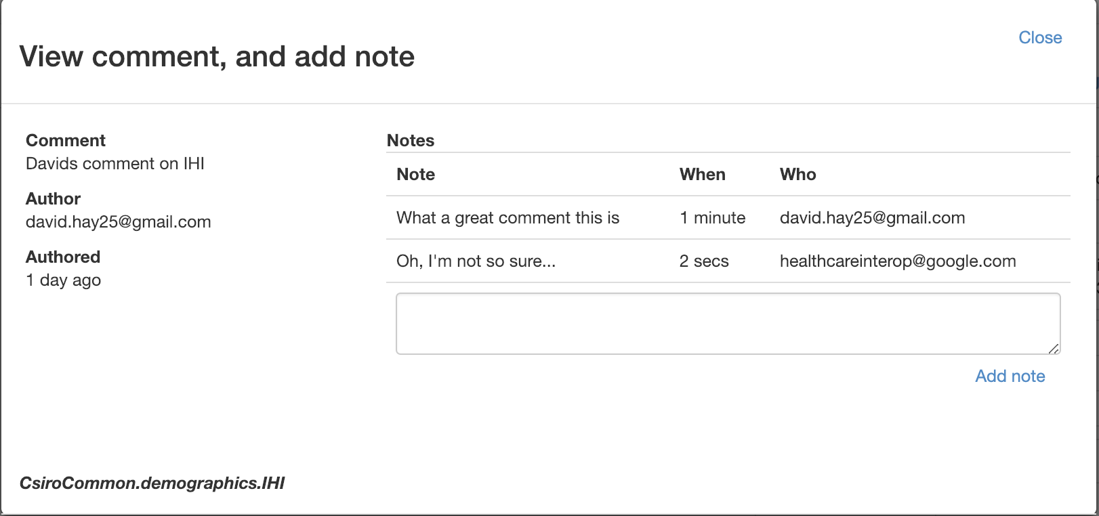
Comment details and notes
Notes that have been added
Details of comment
Add a new note
(Logged in user only)

Slide 12
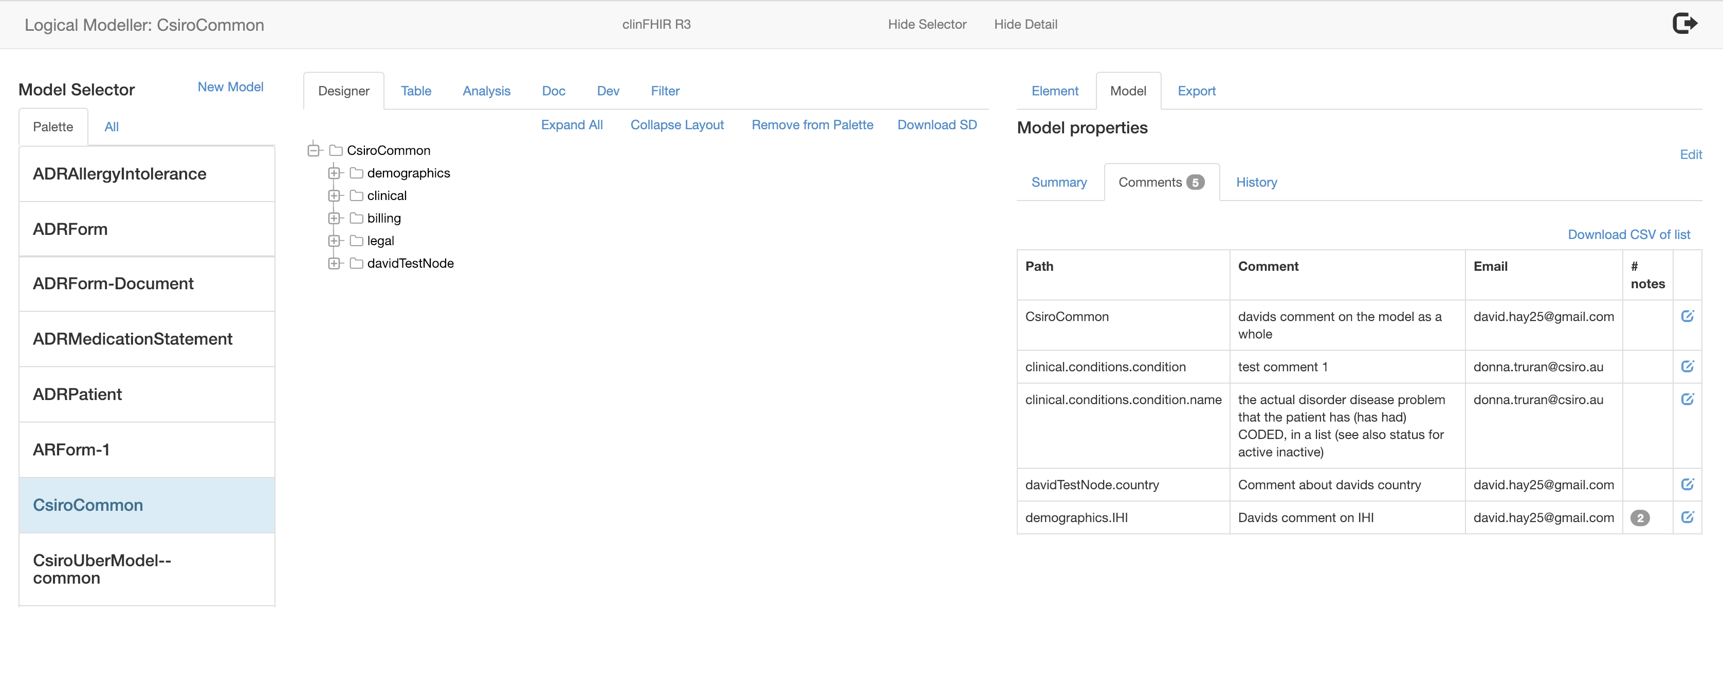
All comments for model
View / Add note

